Slide 1
Data Mining – W11
Structural Topic Modeling

Slide 2
Announcement
Data Camp Optional Homework
Introduction to Text Analysis in R
Text Mining with Bag-of-Words in R
If you have not finished other Data Camp assignments, do them before May 22.

Slide 3
Presentation Results
May 4:
Jason
Alexander
May 11:
Kana Tateishi, Anna Lui, Joshua Demonteverde
Cynda Whitehall, Damayra
Hazal Gursoy, Madelyne
Katherine Liranzo

Slide 4
How it works?
Step 1: Presenters send me a link before the beginning of the class (latest 5PM on Monday, May 4/ May 11), if you use Screen-o-Matic. Otherwise, you and your team will present live on Zoom
Step 2: Class will watch the video, or presentation together, and ask questions on the shared Google Doc (
Step 3: Author(s) lead the Q&A

Slide 5
Link to Q&A
https://docs.google.com/document/d/1Vlk6W1QffAuULjf-KofRcDfu9g_QlTtZheCY8qkXoj4/edit?usp=sharing

Slide 6
Questions?

Slide 7
Constructive questions to ask author(s)
Data:
where do they get the data?
how they clean it ?
Analysis:
What types of analysis do they conduct?
What kinds of R packages do they use?
Substantive questions about the research questions
Implications of the research

Slide 8
Structural Topic Modeling

Slide 9
Content
Topic Modeling
Pre-processing and feature selection
Structural Topic Modeling and Parameter Tuning
Model Validation
Estimating and interpreting STM prevalence and content effects

Slide 10
Code and Data
STM_script.R on class github
Dataset: cuomotweets_df (cleaned dataset from week 10)
R libraries: tidyverse, stm

Slide 11
Sentiment Analysis
Each word has a fixed sentiment score by algorithm
Calculate the average for the entire sentence

Slide 12
Theoretical Background: How do topic models work?

Slide 13
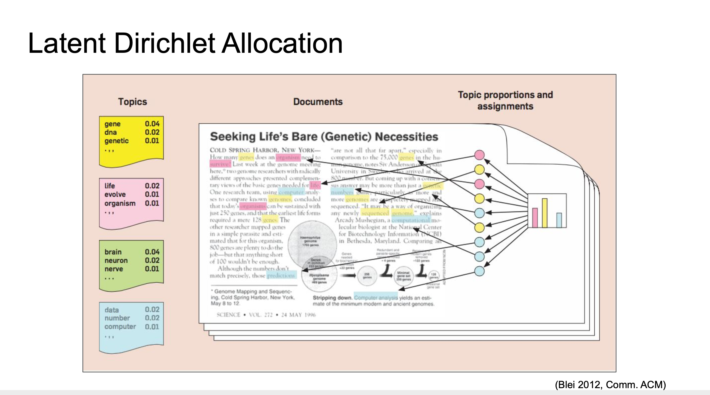
Latent Dirichlet Allocation

Slide 14
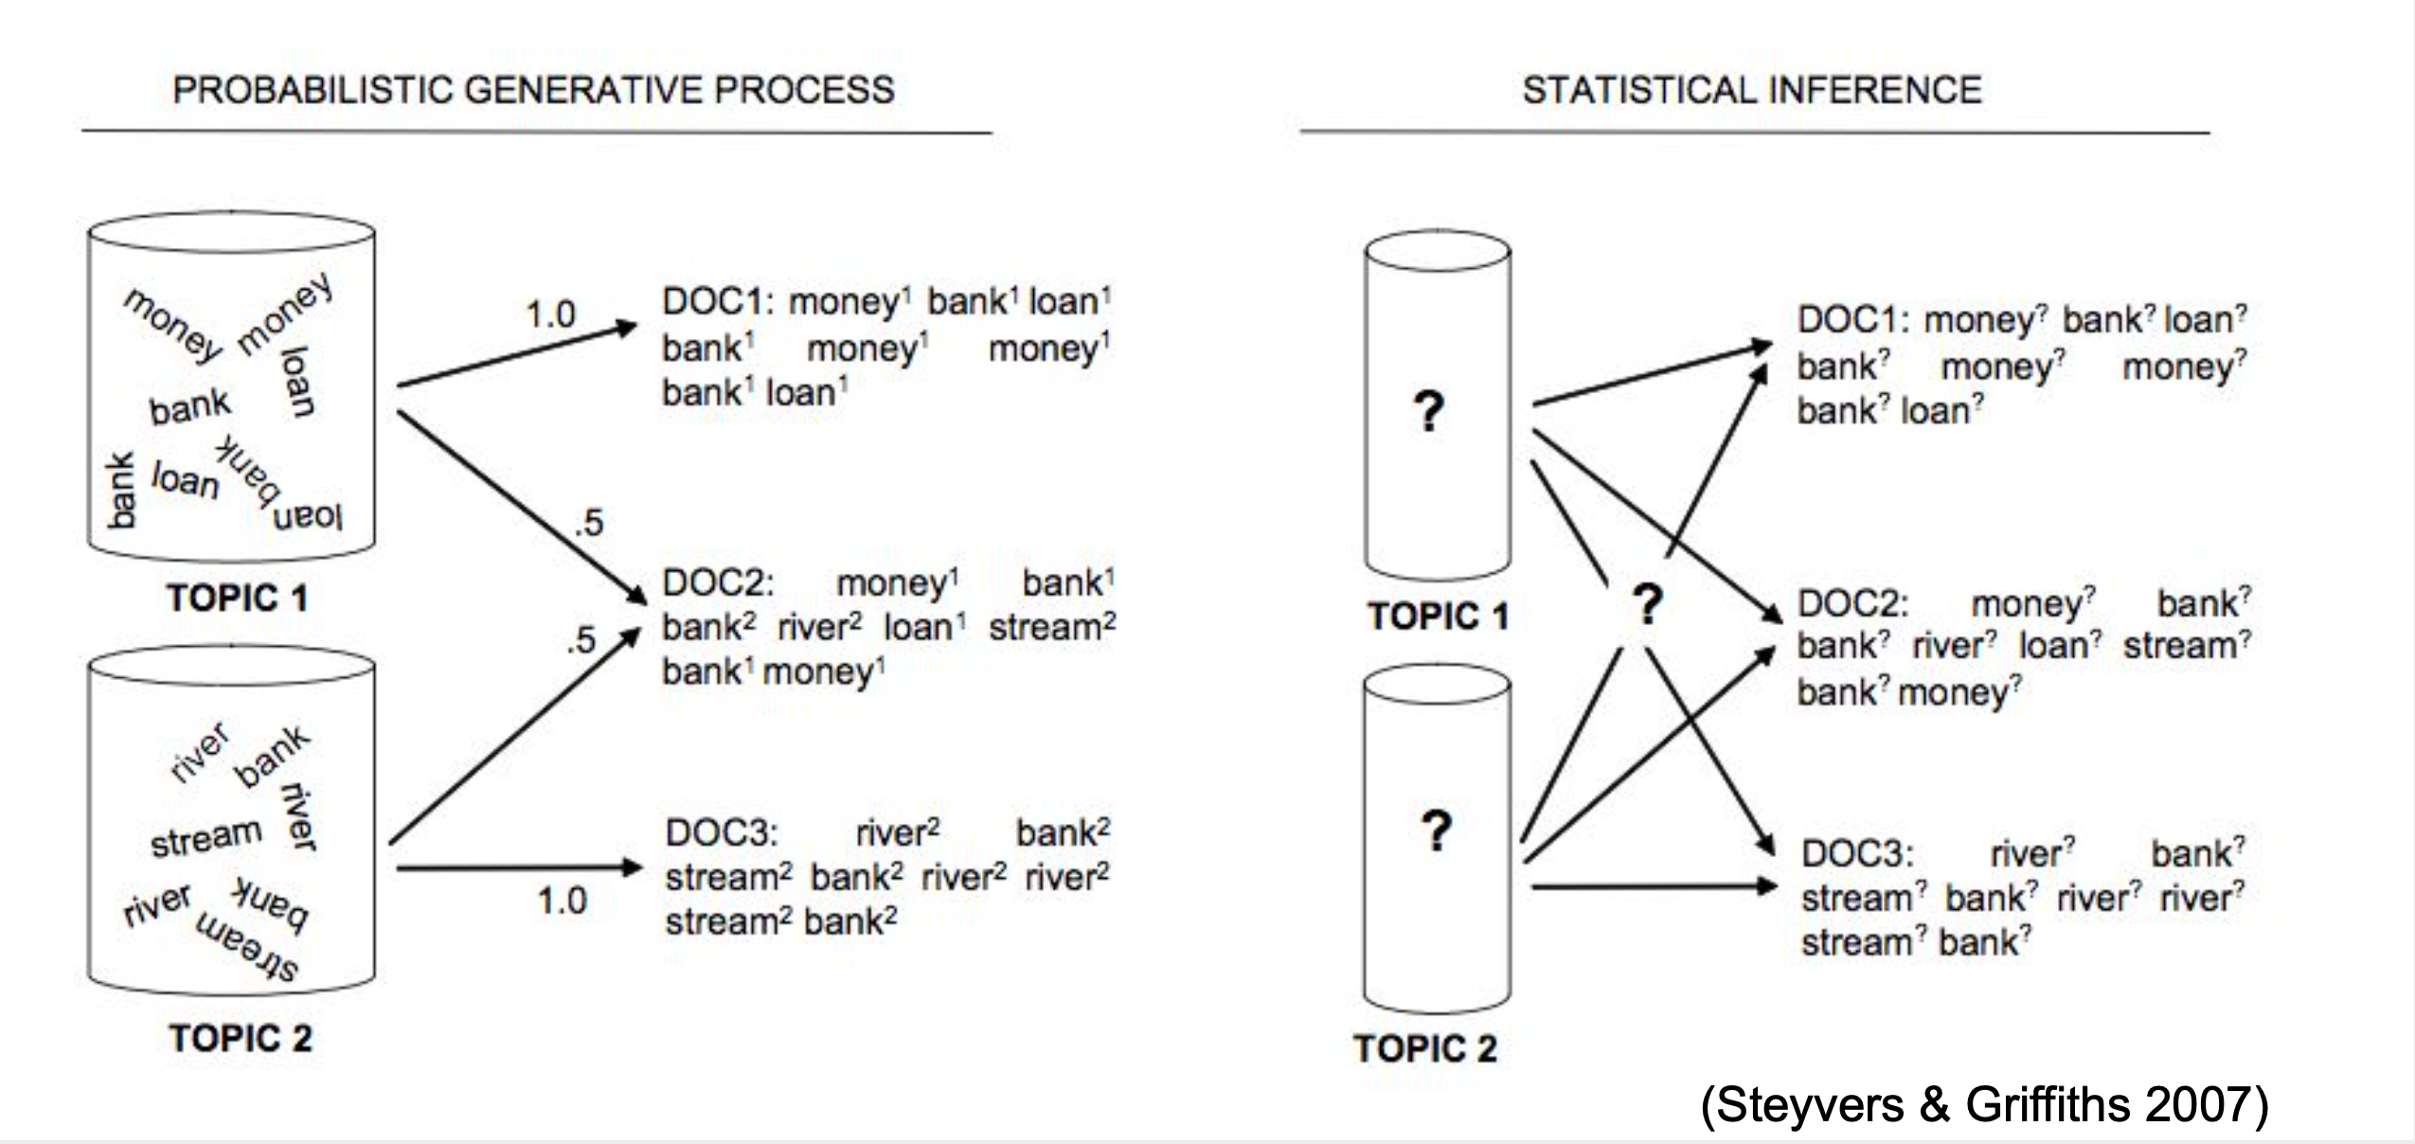
Topics: generation vs. Inference

Slide 15
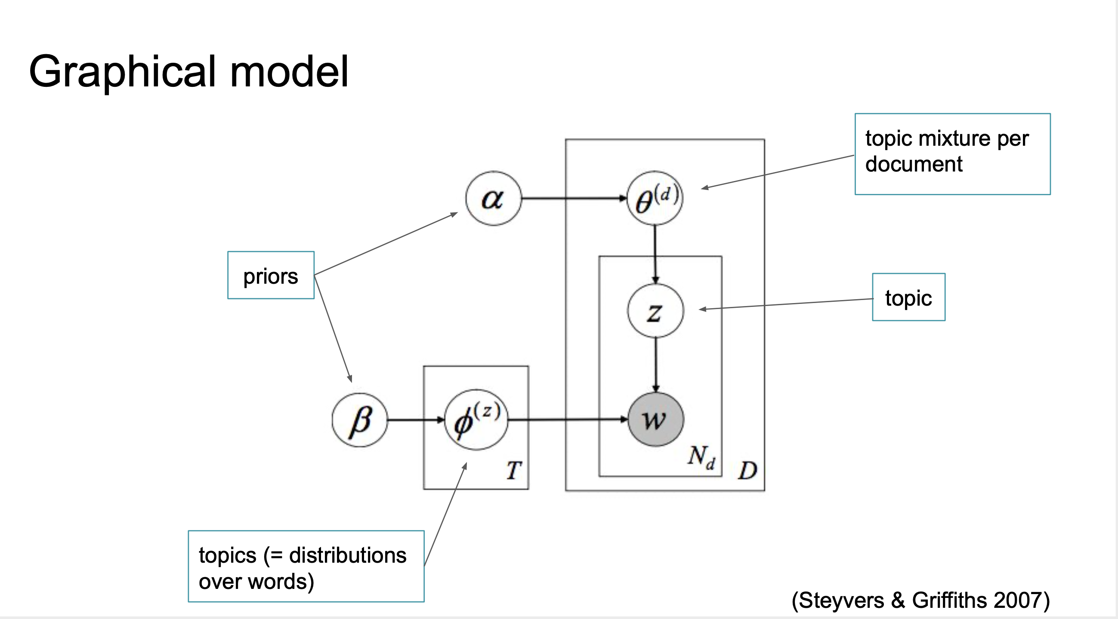

Slide 16
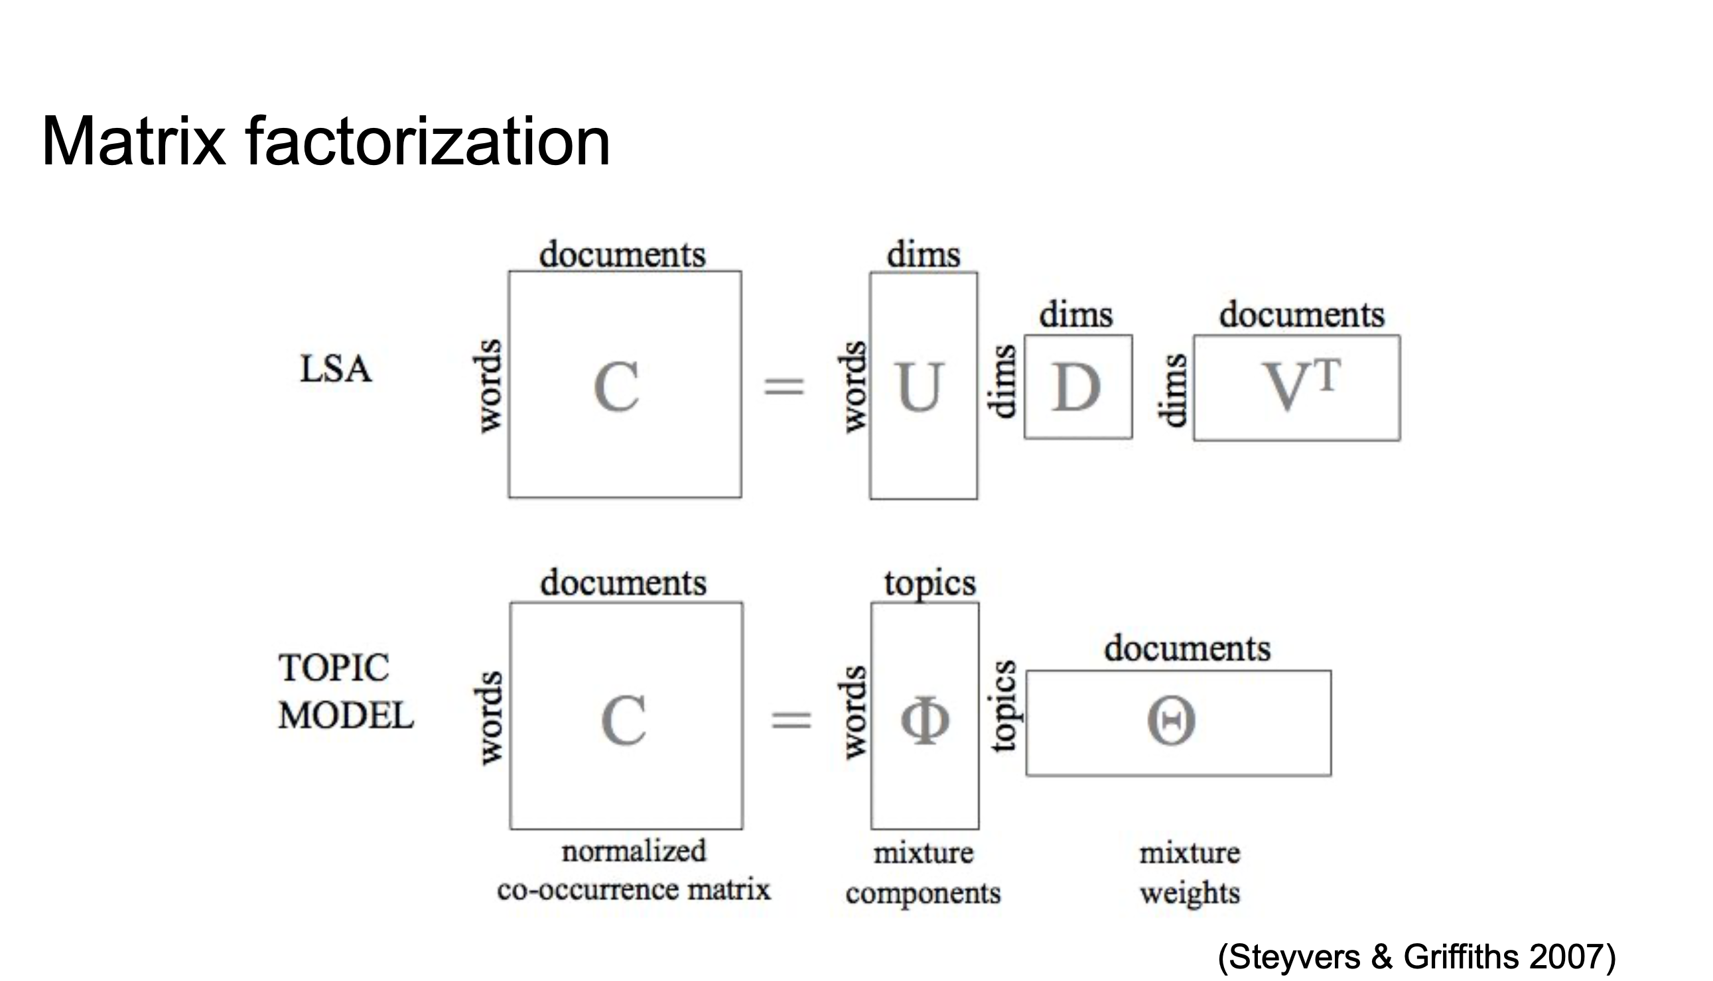

Slide 17
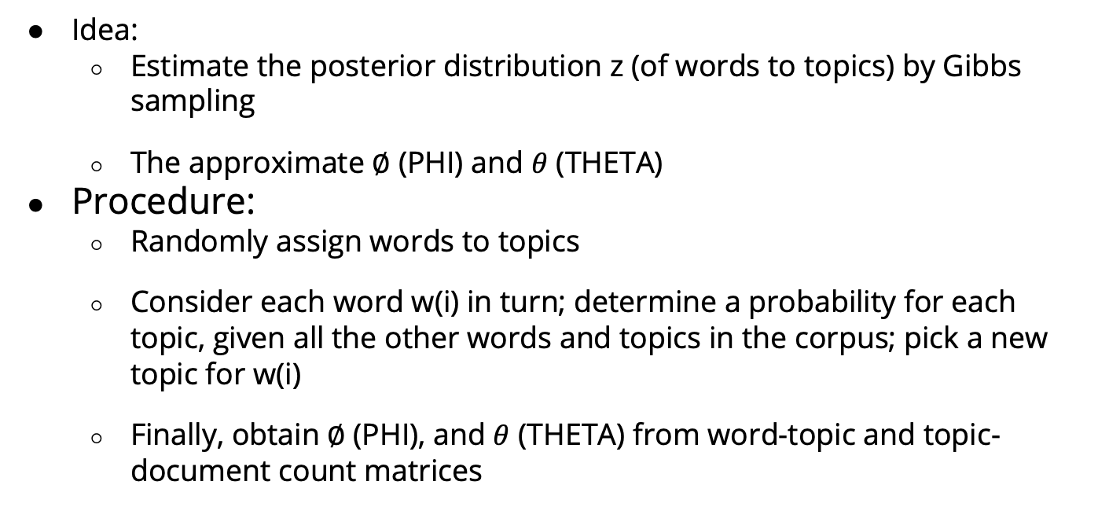
Learning an LDA topic model
Idea:
Estimate the posterior distribution z (of words to topics) by Gibbs sampling
The approximate $∅$ (PHI) and $θ$ (THETA)
Procedure:
Randomly assign words to topics
Consider each word w(i) in turn; determine a probability for each topic, given all the other words and topics in the corpus; pick a new topic for w(i)
Finally, obtain $∅$ (PHI), and $θ$ (THETA) from word-topic and topic-document count matrices

Slide 18
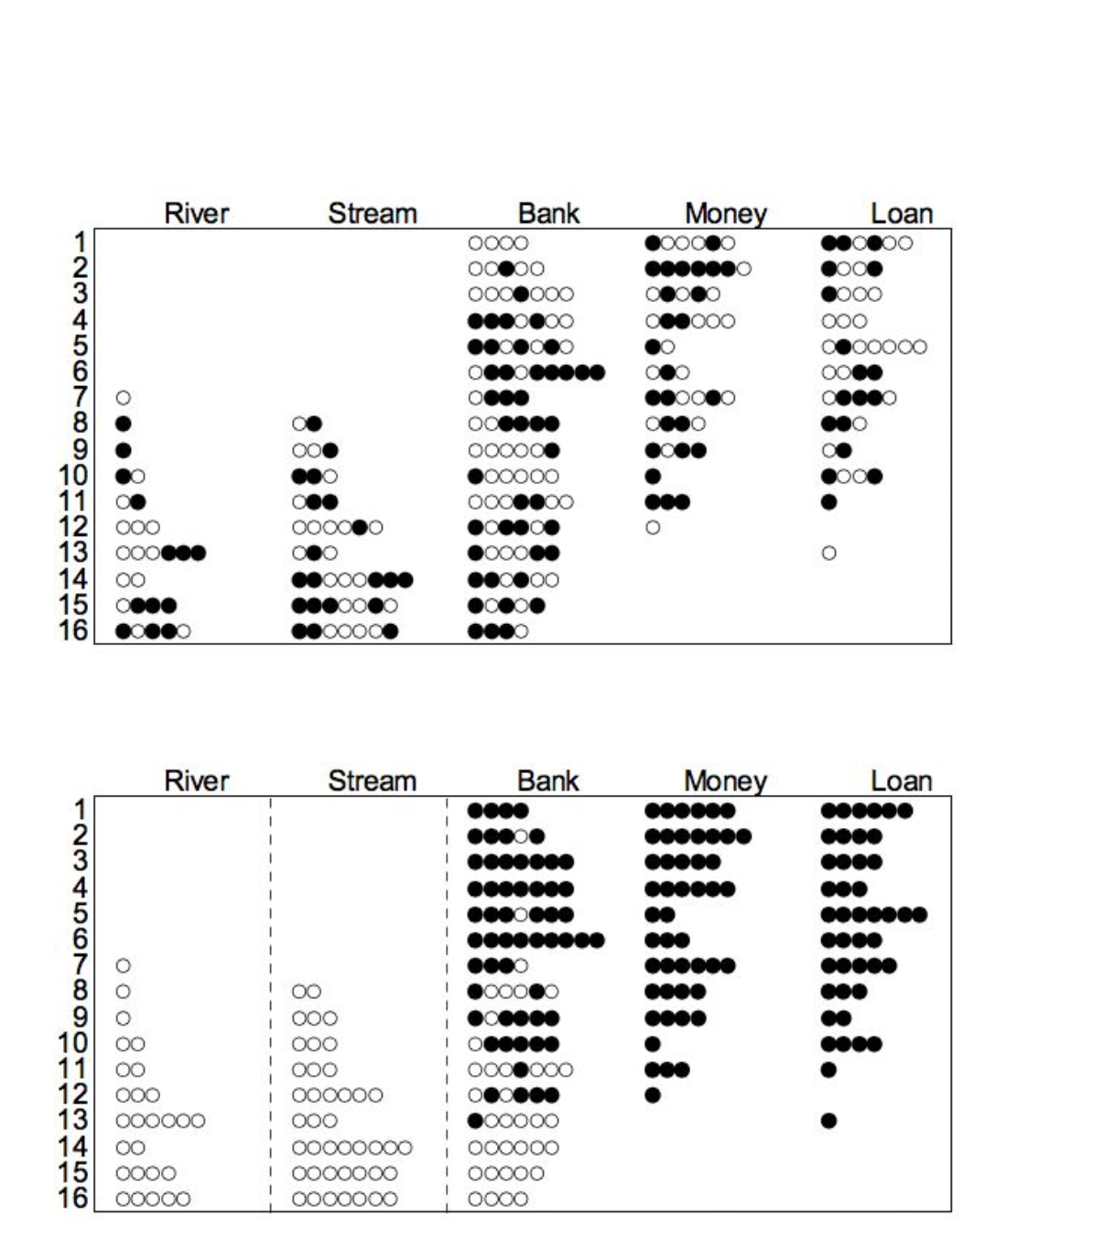
Example
16 documents (generated from 2 topics)
Random assignment of words to topics
(top panel)
After 64 iterations, topic structure
Becomes clear (bottom panel)
Source: Steyvers & Griffiths 2007

Slide 19
From text to features: preprocessing, tokens, n-grams

Slide 20
From Text to Features
A text is a long string of characters, but we want numerical features
Represent each text as a vector of word frequencies ( “bag of words”) -> term-document matrix
However
Not all words are important (stopword removal)
Some words might be more important than others (raw frequencies vs. tf-idf scores)
Words that are almost the same shouldn’t be treated differently (case, punctuation, stemming)
What about two-word expressions like “Covid19 Pandemic” (ngrams)

Slide 21
Preprocessing your data
Stop word removal is typically an aspect of preprocessing
Other steps may include
Remove punctuation, numbers, separators, symbols, URLs
Tokenization
Stemming
Tagging
Parsing
Short stopword lists may only include a handful of high frequency terms (the, to, and, of, …) extensive ones may include 200-300 terms (for English dictionary)

Slide 22
Why remove stopwords?
The underlying assumption when removing tokens is that documents contain ”noise,” i.e. material that is not conducive to the analysis
But it is generally difficult for humans to anticipate in advance which words will be important for
Words is a document != words in isolation
Words in a document can be
Semantically meaningful
Reliably indicate a particular speaker or context

Slide 23
Determining what goes onto your stop word list
Usually these are function words such as articles, pronouns and conjunctions
Nouns, verbs and adjectives are typically the word classes that are retained
It may also be favorable to remove very high frequency common nouns as well as search terms that you need to generate a corpus
Stop words can be filtered relying on a list which may be compiled in several ways
Using a manually compiled list, or list from the Web
Using a corpus of common English words such as COCA or Web 1T 5-gram
Using heuristic procedures such as TDF-IF

Slide 24
Caveats of manual lists
The main drawback is that they are insensitive to frequency variation between corpora
Human are bad at guessing which words are highly frequent and normally distributed
Humans are also bad at guessing what particular words may be meaningful in a given context
This problem doesn’t go away when using standard language corpora (COCA, Web 1T 5-gram) because your corpus may be different

Slide 25
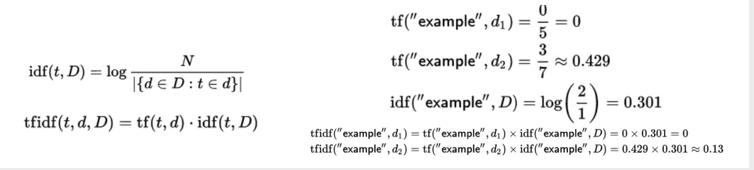
TF-IDF
Term frequency – inverse document frequency (TF-IDF) is a metric commonly used in information retrieval (IF), for example in recommender systems
Among the most popular term-weighting schemes
Weighs the frequency of a term within a particular document (IDF) in relation to its frequency within the entire corpus (TF)

Slide 26
Alternative: Use a dictionary or thesaurus
When using a dictionary or thesaurus, all words in your corpus are collapsed into a particular lemma
This may be useful for hyponymous relations (France, Spain, US = county) or when a particular word field identifies a concept reliably (see Chrismas in this example)

Slide 27
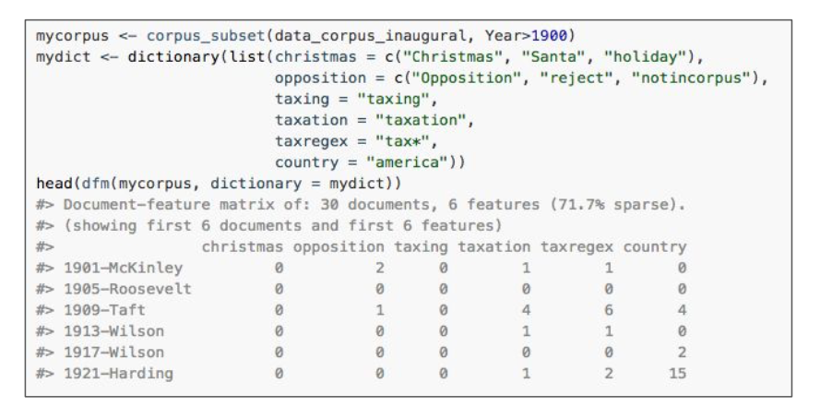
Alternative: Use a dictionary or thesaurus
When using a dictionary or thesaurus, all words in your corpus are collapsed into a particular lemma
This may be useful for hyponymous relations (France, Spain, US = county) or when a particular word field identifies a concept reliably (see Chrismas in this example)

Slide 28
Tuning of the topic number for optimal model fit

Slide 29
What is the optimal k for a given topic model?
There is no definitive single answer, as topics in topic modeling are generative
More topics = fine-grained analysis
Pro: able to capture ”blips” in the data, such as a particular event in social media corpus
Con: lack of focus
Con: topics tend to be redundant

Slide 30
What is the optimal k for a given topic model?
Fewer topics = coarse analysis
Pro: able to capture ”broad strokes,” such as recurring themes in a news corpus
Con: lack of detail
Con: lack of nuance

Slide 31
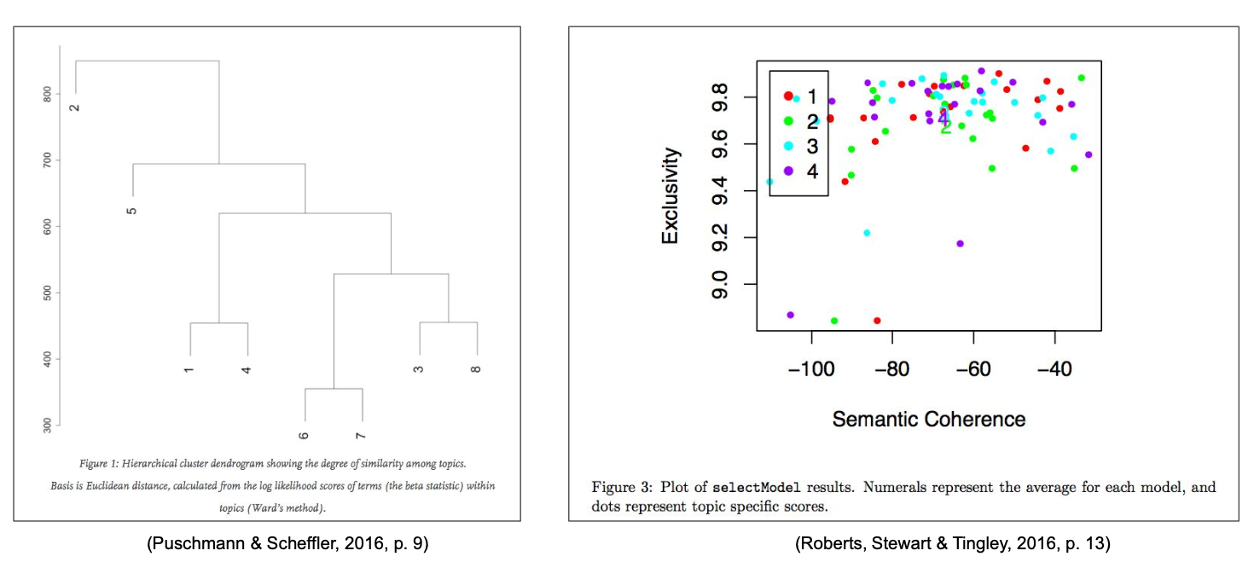
Assessing similarity by clustering/metric comparison

Slide 32
Heuristics for picking optimal k in LDAtuning in R
Package ldatuning for R
Compatible with popular topicmodels package
Implements four different metrics for determining optimal k, papers describing metrics are conveniently provided with the package

Slide 33
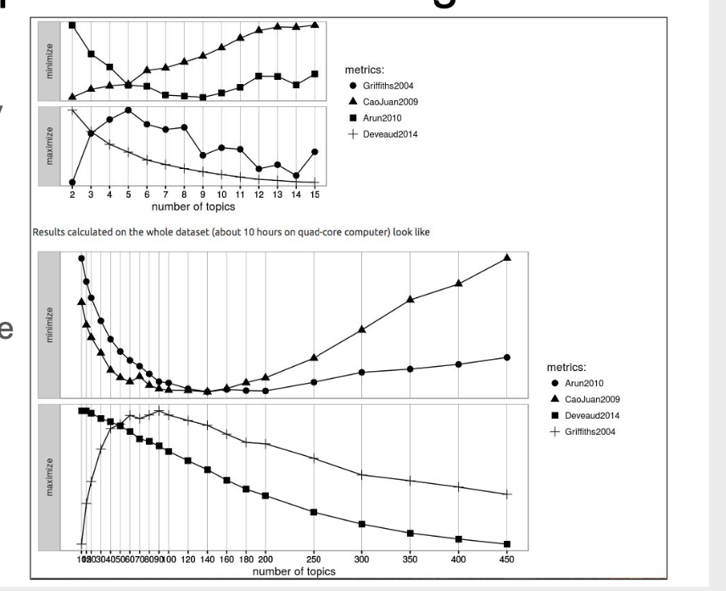

Slide 34
Heristics for picking optimal k in STM in R
Another set of metrics is provided with the STM package
Held out likelihood (Wallach et al. 2009)
Residual analysis (Taddy 2012)
Semantic coherence (Mimno et al. 2011)
Lower bound convergence (Roberts et al. 2016)

Slide 35
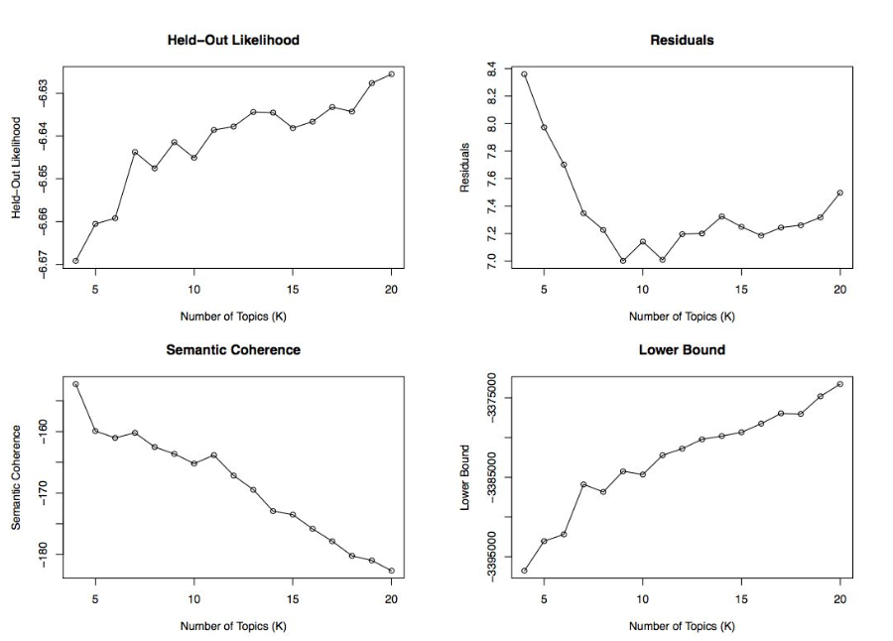

Slide 36
What is the optimal k for a given topic model?
There is no single correct answer to the question of how many topics to model for a given collection
Left and right plateaus in the metric distributions seem favorable choices (left = coarse analysis, right = fine-grained analysis)
Further alternatives:
Model a large number of topics but discard some as junk
Distinguish between topics and issues/themes, the latter of which are collections of topics
Let humans judge the validity of the topics

Slide 37
Introduction to Structural Topic Models

Slide 38
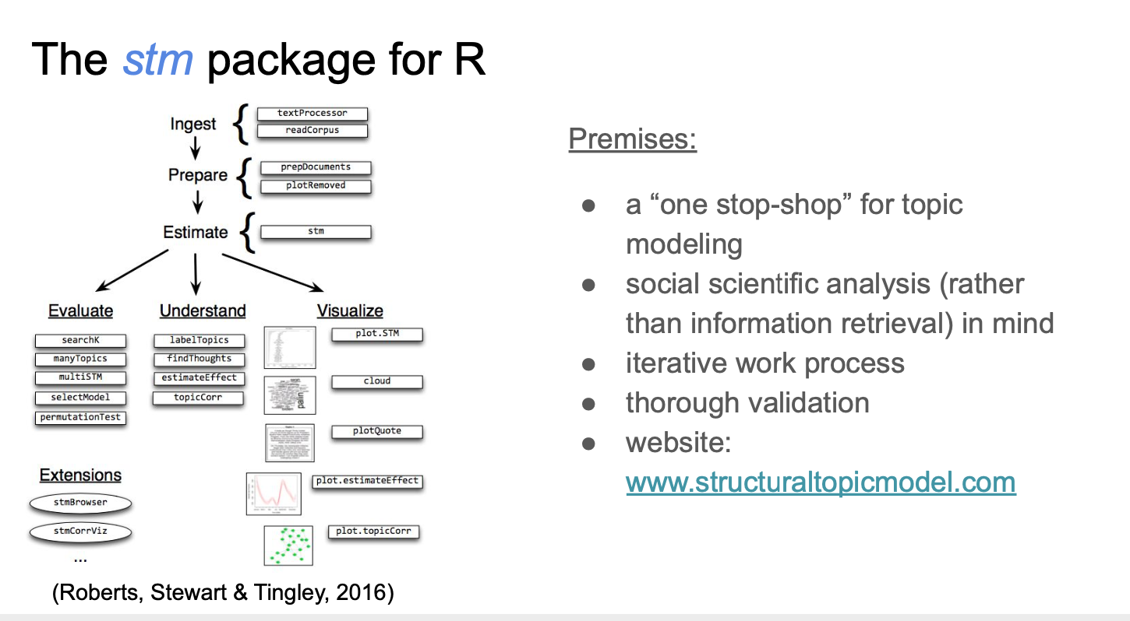

Slide 39
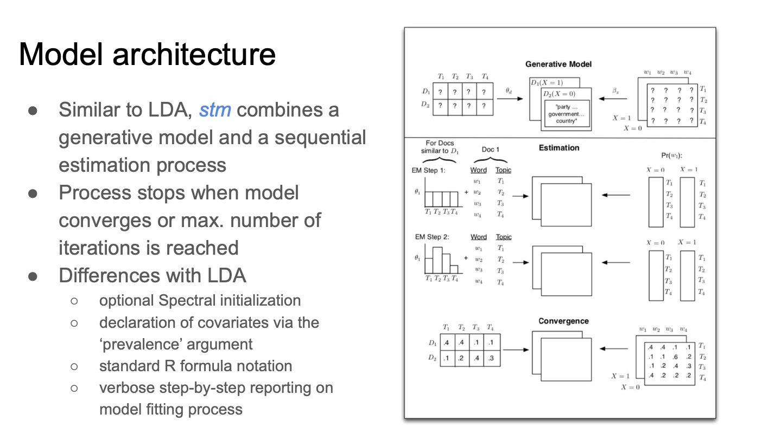

Slide 40
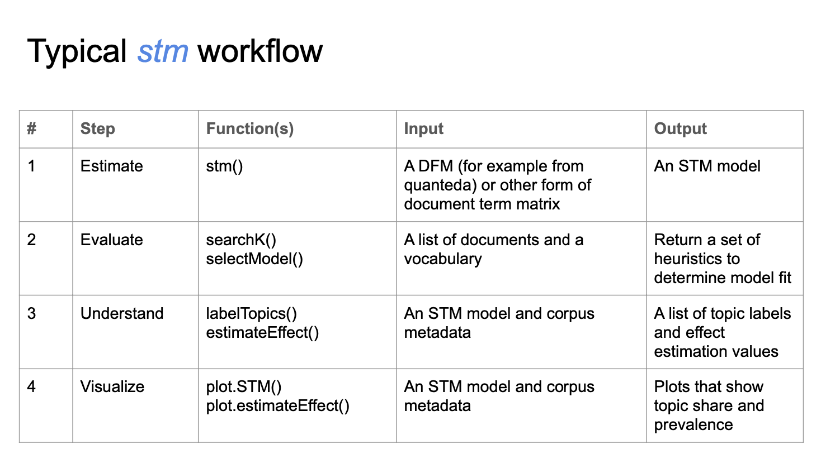

Slide 41
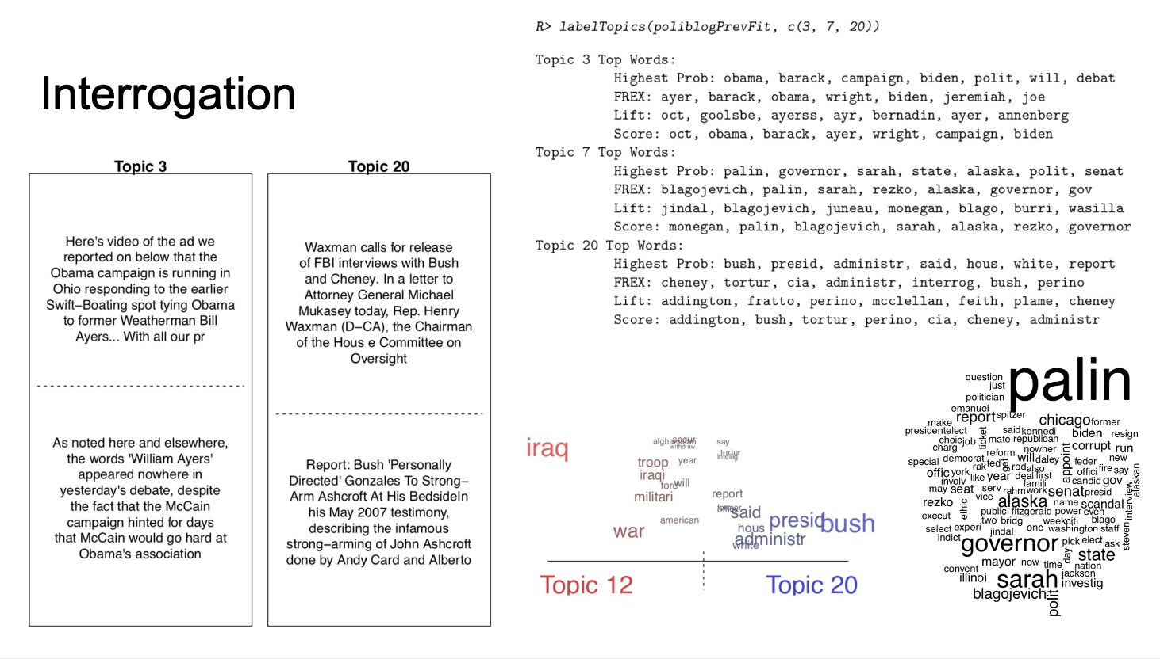

Slide 42
